Slide 1
The Spring Framework
Dan Trong Thai

Slide 2
The Spring Container
Instantiates, configures, and wires components
Utilizes Dependency Injection (IoC)

Slide 3
Spring Beans
The Business Components of the Spring Framework
POJO’s
Two Types of Spring Beans
How are Spring Beans wired?

Slide 4
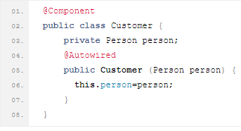
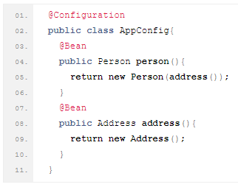
The Spring Configuration
Three ways of configuration
XML-based configuration
Annotation-based configuration
Java-based configuration

Slide 5

SpringLab
XML-based configuration
Define Beans
Spring Container
Represented as the ApplicationContext
Multiple instances, each with its own configuration.
Access Beans

